Slide 1
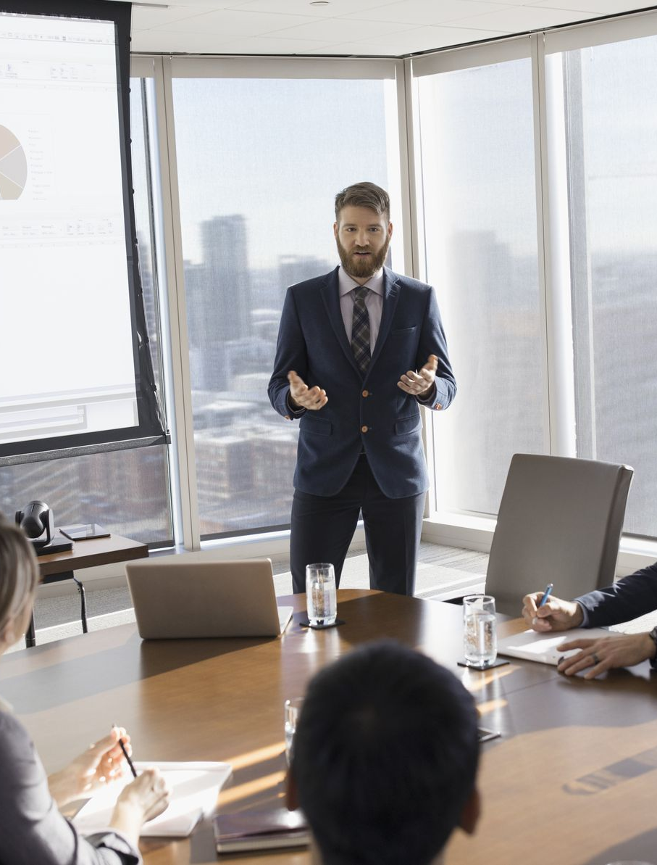
Business Communication Basic Level
Prepared by : Tissa Wijesuriya
PGDE (English Medium) – The University of Colombo
B.A. (The University of Kelaniya)
Advanced English Diploma. (The University of Colombo)
MACO Diploma (The University of Kelaniya)

Slide 2

Tenses Basic grammar for writing purposes

Slide 3

Simple Present Tense

Slide 4
Situations where simple present tense is used
Temporary Situation
I have a headache.
It is windy today.
You seem to be hungry.
She thinks, I am rude.
2) A future time
The present simple can refer to the future in the following cases:
Tomorrow is a holiday.
This course finishes next month.
What time does your plane takeoff?

Slide 5
Situations where simple present tense is used
3) Referring to past time
The present simple sometimes refers to events in the past. This is called the historic present and used in telling stories which is common. This is popular among writers of newspaper in headlines.
250 people die in an air crash
Sri Lanka wins the world cup.
"I dedicate my life for the country. I protect my people. I serve for my religion; king Dutugemunu determines."
4) Referring to running commentary
Here comes Vaas to bowl Sachin. He takes it on bat. There is a loud appeal. He has a narrow save. That is the end of the over
5) Referring to situations or quotations
Lord Buddha says that “Hatred never ceases by hatred. but it ceases by love"

Slide 6
Activity 1: Read the text and fill in the blanks. Use the correct form of the verb.
Artificial Intelligence and Automation
Artificial Intelligence(AI) has become efficient at managing many accounting tasks. Companies can now automate important processes such as completing transactions and compiling statements, which a)………………. (save) the business time and money. Some accountants b)………………. (worry) that the increase in automated programs may one day c)………………. (make) their jobs obsolete, but this industry still d)………………. (need) humans to perform advanced tasks and e)………………. (ensure) the accuracy of automated processes.
AI f)………………. (give) accountants more time to focus on their duties such as helping clients with specialized accounting needs and staying updated on accounting trends

Slide 7
Activity 2: Write the next part of the sentence appropriately
Text law changes occur annually …………….
When employees work at a single office,……………………..
When they work in different regions …………
Marketing operations is a term ………………..
Marketing orations …………………………
Like every other business sector, ………………
As AI becomes the standard in many accounting firms, …………………………
Most services in the accounting industry ………………..
The cloud is becoming ………………….
the accounting industry needs to understand …………………
that describes the functions of marketing within an organization
typically focuses on four key areas
and accountants adjust their processes accordingly
the accounting profession is rapidly changing
Are vulnerable to disruptions
the same laws apply to each employee
blockchain technology move for good reasons
payroll becomes more complicated the companies
popular place for accounting services
the role of the accountant will change as well

Slide 8
Activity 3: Fill in the blanks with the correct form of the verb.
I ………………. (study) English every day.
We ………………. (teach) English.
He ………………. (pay) me well.
Danielle ……………….(fly) to Paris once a year.
She never ………………. (do) her homework.
This girl always …………. (push) somebody.
They ………………. (want) to do something special tonight.
David never ………………. (mix) eggs and vinegar together.
The room ………………. (to be) on fire.
I usually ………………. (help) my mother cook.
You still ………………. (believe) in Santa Claus.
My neighbor ………………. (have) a new car.
My sister ………………. (speak) Spanish.
Frank ………………. (go) to work every day.
Martha and Paul ………………. (swim) twice a week.
John never ………………. (leave) the country.
Summer ………………. (be) hot.
He ………………. (miss) her a lot.
I ………………. (like) you.
Stella ………………. (sing) "Let it go".

Slide 9
Activity 4: Complete the text using the Present simple tense.
(1)……………. you ………………… (like) sport? My sister (2) ……………. (love) sport. She usually (3) ……………….. (go) swimming on Tuesdays and Thursdays and (4) ………………. (do) karate on Fridays. My friends Andrew and Keira
(5) ……………. (not do) much sport.
What (6) ……………….. they (do) in their free time? They (7) ……………….. (not play) football and they (8) …………………. (not do) gymnastics. They
(9) ……………. (be) very lazy! Andrew often (10) ……………….. (chat) on the Internet and Keira (11) ……………….. (write) e-mails.

Slide 10

Assignment
Write a conversation which can be taken place between you and interviewer for a job over the phone. One must speak at least eight times. (Use simple present tense and appropriately )

Slide 11
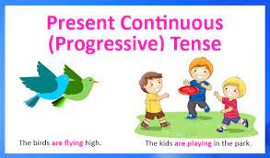
Present Continuous Tense

Slide 12
The Present Continuous Tense
The present continuous tense is used for actions happening now or for an action that is unfinished. This is also used when the action is temporary.
The structure of the present continuous tense;
Helping verb(am/is/are) + main verb + ing
Auxiliary (be verb)

Slide 13

Study the following examples
Companies are seeking the candidates who possess strong accounting skills.
Accounting skills are making our lives easier.
They are summarizing the data in excel sheets.
He is preparing a budget in order to seek over expenses.
We are looking at inventory, expenses and cash flows.

Slide 14
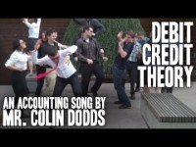
Activity 1: Watch the video clip and write five things happening there
https://www.youtube.com/watch?v=j71Kmxv7smk

Slide 15
Activity 2: Arrange the jumbled words in order to make meaningful sentences.
increasing / production / their / daily / is
inquiring / manager / is / about / the / balance sheet / about
business / running / smoothly / is / their
managers / discussing / right now / are / the /insurance / about / fits /
for / which / them
petty cash / these / is / he / calculating / days
decision / about / all / making / appreciating / are / his

Slide 16
Activity 3: Respond at each situation. One has been done for you .
1) Mother - cook - kitchen Mother is cooking in the kitchen
2) They – promote - goods - now …………………………………..………….
3) They - make - policies - business ……………………………………….….
4) The - manager – summarize - sales - this month ………………………..…..
5) He - handle – customers – we ……………………………………………..
6) She – consider - complaints - made –customer ……………………….…..

Slide 17

Activity 4: Write sentences about what is happening now

Slide 18
Activity 5: Write meaningful sentences from the given words. One is done for you
write - report
watch - news
Your boss – conduct - meeting
Mother – wash - clothes
Your friends - talk - about sales
plan - a business
neighbors - enjoy - party
it - train
I am not writing a report.
……………………………………………….
I am watching news.
……………………………………………….
……………………………………………….
……………………………………………….
……………………………………………….
……………………………………………….
……………………………………………….
……………………………………………….

Slide 19
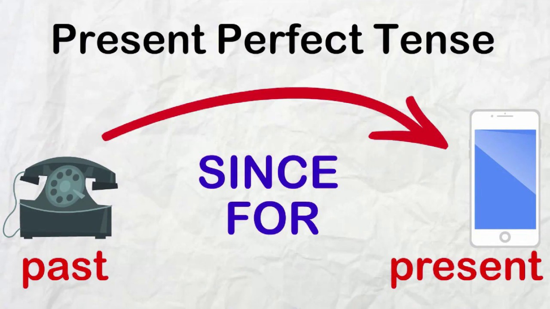
Present Perfect Tense

Slide 20
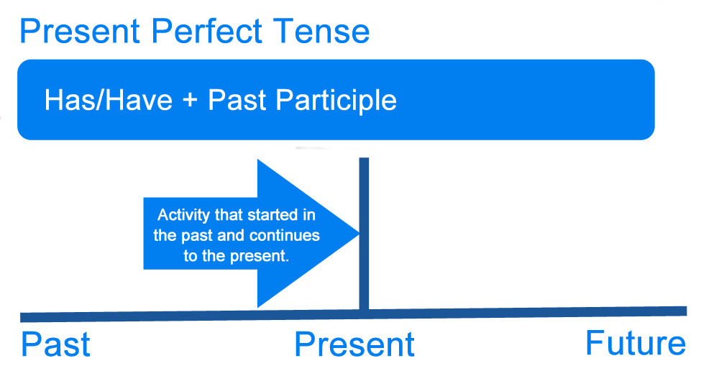
What is Present Perfect?
The present perfect tense is the tense which is used to express an action which was happened in the past but has a connection with the present
The action has finished
Time is not definite
There is a connection with the present
Later identify or remind
Important*

Slide 21
Study the following examples
They have increased their production
The economic crisis has affected to all the sectors in the country
The production sector has decreased for this term
They have recorded many issues in the company
Some companies have shut down their productions due to the economic crisis
The manager of the company has written all the reports regarding that.

Slide 22
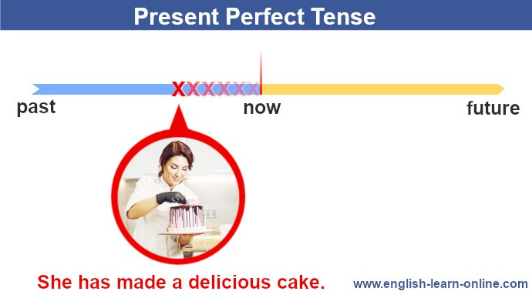
How to form Present perfect?
Singular
Subject + Has + Past Participle
Plural
Subject + Have + Past Participle

Slide 23

Assignment
1)List out 10 effects which have been identified from the economic crisis in Sri Lanka (Use Present perfect tense)
Eg: The prices of almost all the goods have increased
2) Do a presentation on the benefits that people have gained after introducing new technology to the banking sector
Eg: Internet banking, credit cards

Slide 24
Activity 1: Write meaningful sentences using present perfect tense for the situations given below. One has been done for you
Proposal/handover
I have already handed over the report to the management
2) Annual report/write
…………………………..............................................................
3) Accept/ payments
…………………………..............................................................
4) Manager/board meeting
…………………………..............................................................
5) Launch/new business
…………………………..............................................................
6) Face/economic crisis
…………………………..............................................................

Slide 25

Activity 2: Some other situations where present perfect tense is used
They have already finished the project
They have not finished the project yet
She has gone to the markets (Now she is not at home)
She has been to the market (Now she is at home )
I have worked in this company for five years
I have worked in this company since 2018
This is the first time our company has opened a showroom in abroad
This is the second time the workers have called out their strike

Slide 26
Activity 3: Fill in the blanks using present perfect tense
Artificial intelligence …………………(become) efficient at managing many accounting tasks
The board …………………(decide) to uphold the appeal
They…………………(receive) all the mails for this month
She …………………(write) all the reports accurately
The management of the company ………………… (launch) a new chain among their companies

Slide 27
Activity 4: Rearrange the words to make a meaningful sentence
business / have / dedicated / they / in the
have / set / goals / they / to / their / achieve
improvements / we / notable / have/ had / in / retail payments
done / transparency / without / transactions / they
has / responsibility / the / taken / government / crisis / economy

Slide 28
Negatives and Questions
Negatives
They have not considered about the payment modes
The bank has not launched any loan schemes for this year
Some people have not adapted for the financial arena
Questions
Has she finished the projects?
Have the staff members gathered to the conference?
Hasn't he completed the report?
Haven't they received the awards for their new inventions?

Slide 29
The End!

